Slide 1
Save the Data: How to Protect Data
Wherever It Lives
16 November 2016
Robert Thibadeau
Drive Trust Alliance and Trusted Computing Group

Slide 2
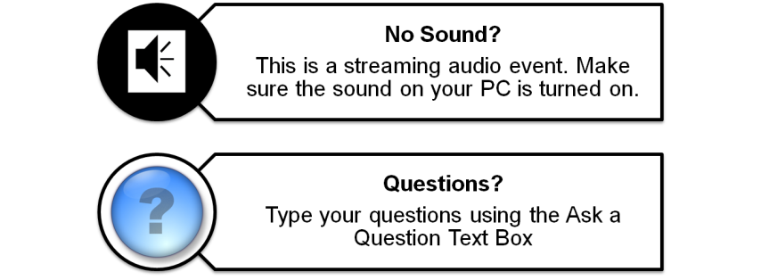
Webcast Logistics

Slide 3

Today’s Presenters
Dr. Robert Thibadeau, Drive Trust Alliance
Dr. Robert (Bob) Thibadeau pioneered self-encrypting drives during his tenure as Chief Technologist of Seagate Technology, LLC from 2002-2009. He has also served as the Chair of the Storage Workgroup in the Trusted Computing Group. Dr. Thibadeau was one of the founding directors of the Robotics Institute at Carnegie Mellon University from 1980-2008. He is the inventor on over 30 US patents, and he holds degrees from Emory University and the University of Virginia. Bob currently co-leads Drive Trust Alliance, is CEO of Bright Plaza.

Slide 4
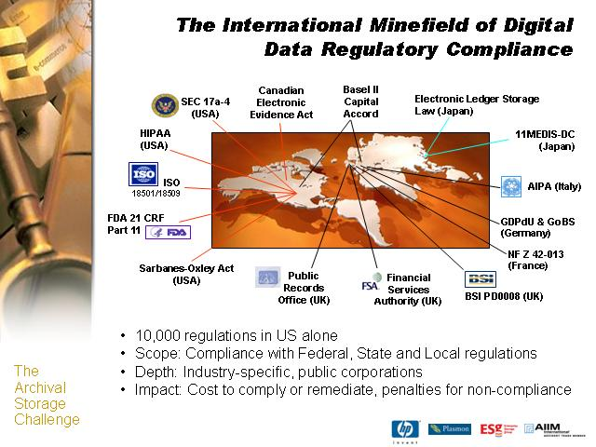

The Problem…
184,653,143 records have been lost from portable and stationary devices (computers, drives, portable drives, etc.) in reported data breaches 2005-2016 (1)
The 2016 Ponemon Cost of Data Breach Survey says the cost for each lost or stolen record containing sensitive and confidential information increased from a consolidated average of $154 to $158. The global study puts the likelihood of a material data breach involving 10,000 lost or stolen records in the next 24 months at 26 percent.
1 https://www.privacyrights.org/data-breaches
2 https://securityintelligence.com/media/2016-cost-data-breach-study/
Drive Trust Alliance

Slide 5
The Problem…
2005-2013: over 864,108,052 records containing sensitive personal information have been involved in security breaches
In 2013, U.S. businesses paid an average cost of $5.4 million per data breach; that’s $188 per record
$5.4 Million Per Incident
Legal
Financial
Reputation
5
Drive Trust Alliance

Slide 6
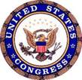
Why Encrypt Data-At-Rest?
  Threat scenario: stored data leaves the owner’s control – lost, stolen, re-purposed, repaired, end-of-life, …
  Compliance: as of Jan. 2016, forty-seven states, the District of Columbia, Guam,
  Puerto Rico and the Virgin Islands have enacted legislation requiring private,
  governmental or educational entities to notify individuals of security breaches of information involving personally identifiable information.
  EU: Data Protection Directive 95/46/EC (27 countries) replaced with
  European Data Protection Regulation ³ : requires breach notification ²
  Obsolete, Failed, Stolen, Misplaced…
    Nearly ALL drives leave the security of the data center
    The vast majority of retired drives are still readable
http://www.ncsl.org/IssuesResearch/TelecommunicationsInformationTechnology/SecurityBreachNotificationLaws/tabid/13489/Default.aspx
2. https://www.eiseverywhere.com/file_uploads/4982c29aa16310269434b49b0ac62eed_EricHibbard_Data-Breach-Encryption-Safe-Harbor_Final.pdf
3. http://en.wikipedia.org/wiki/General_Data_Protection_Regulation

Slide 7
Breach Notification Legislation Example: California
“… any agency that owns or licenses computerized data that includes personal information shall disclose any breach of the security of the system following discovery or notification of the breach in the security of the data to any resident of California whose unencrypted personal information was, or is reasonably believed to have been, acquired by an unauthorized person…”
Encryption “safe harbor”
Drive Trust Alliance

Slide 8

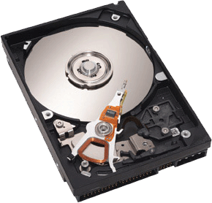
TCG Standards for Self-Encrypting Drive (SED) for Client (Opal) and Data Centers
Trusted Computing Group
SED Management Interface
Authentication Key
I n t e r f a c e
Encryption Key
AES Hardware Circuitry
Encrypt Everything Written
Decrypt Everything Read
Encryption is in the drive electronics
Drive Trust Alliance

Slide 9
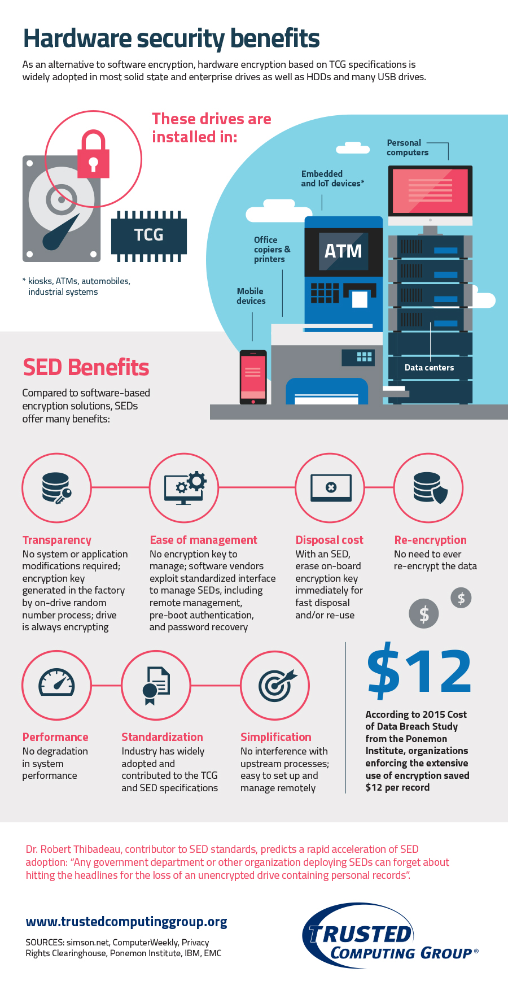
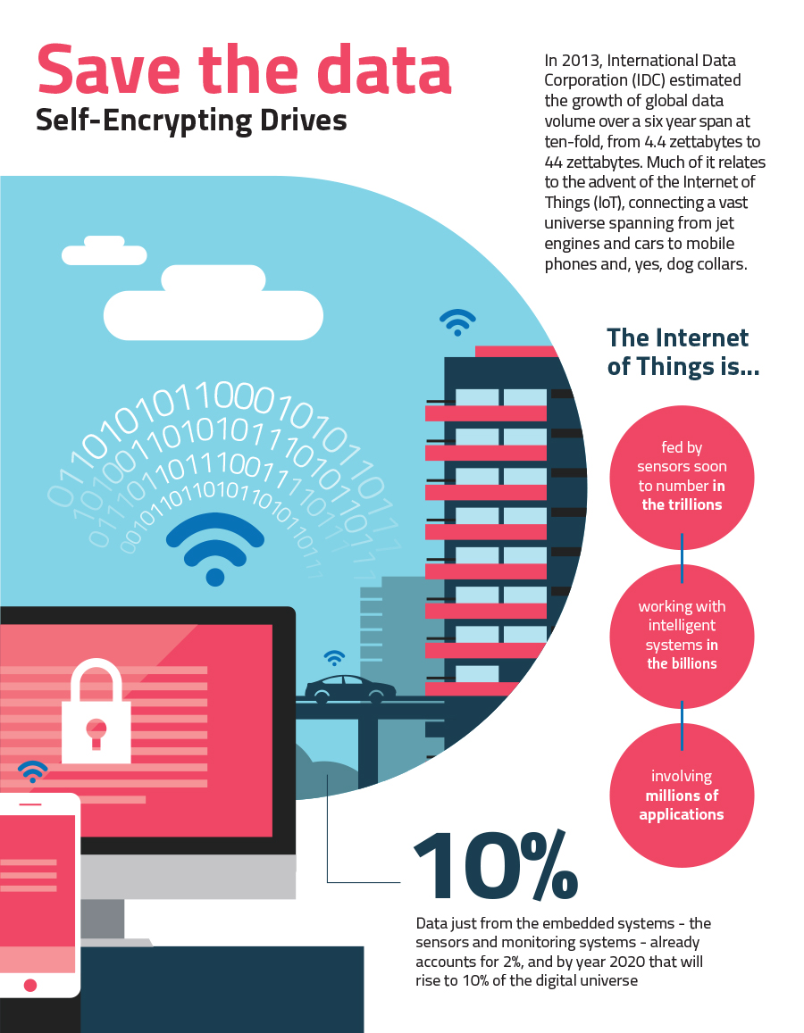
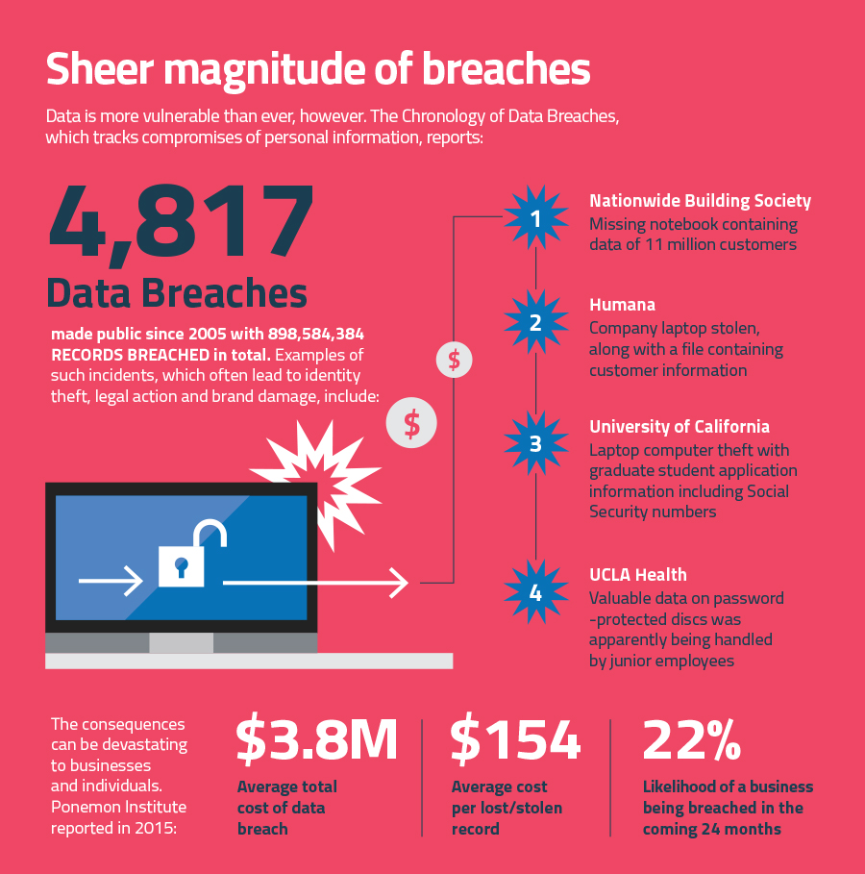
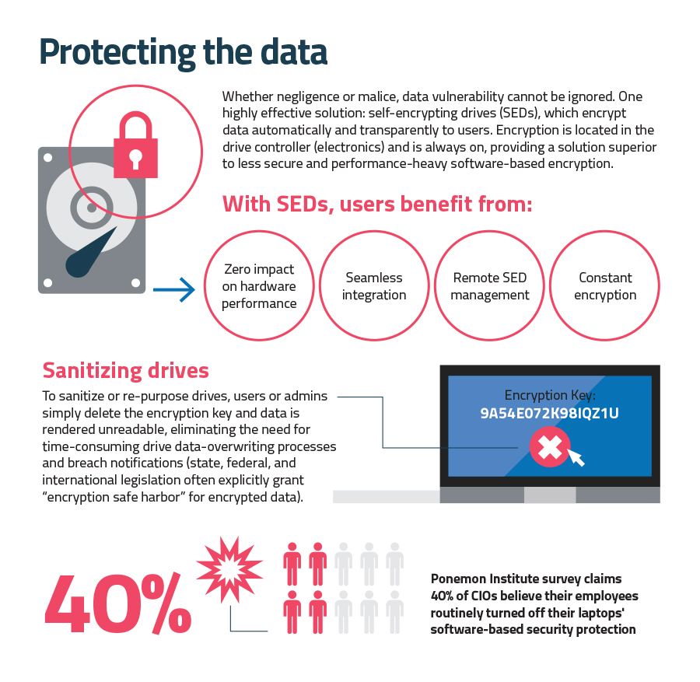
TCG SED Infographic
(see website for larger type!)
http://www.trustedcomputinggroup.org/wp-content/uploads/Infographic-TCG-SED.pdf

Slide 10
Benefits of TCG Standards-based SEDs
Simplified management
Always-on security
Support WW compliance regulations
Breach notification exemption with ”safe harbor”
Reduction of drive disposal costs
Scalable
Interoperable
Built-in security, not added-on later (“Built in, not on”)

Slide 11
How Do SEDs Compare to Software Encryption?
Transparency: encryption key is generated in factory for SEDs
Easy to manage: Encryption key never external to drive
Lifecycle costs: SED costs are in initial drive acquisition, at parity with non-SEDs. SW requires licensing and other lifecycle costs
Disposal and re-purposing costs: SEDs require NO re-encryption of data, saving time and money
Performance: SEDs do not impact performance of drives, whereas SW encryption often slows drives
Standardization: users benefit from widely vetted standards and best practices

Slide 12
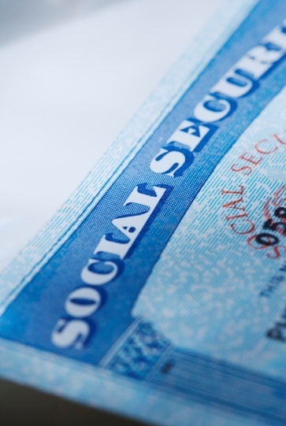
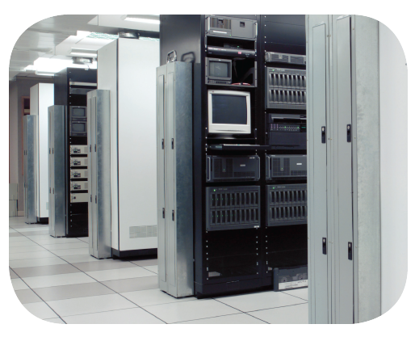
Huge Issue: IT Retires Drives Constantly
All drives are retired eventually. Why?
End of life
Returned for expired lease
Returned for repair or warranty work
Repurposed
50,000 drives leave data centers daily
Exposure of data is expensive - $6.65 million on average
90% of retired drives are still readable (IBM study¹)
SEDs provide a simpler, cheaper way to retire drives
Without risking data leakage and breaches
1: http://www.redbooks.ibm.com/redpapers/pdfs/redp4529.pdf
Drive Trust Alliance
Notes:
Drive Product Announcement made with IBM April, 2007. Product Announcement made for 3.5” 15K and 2.5” enterprise drives.
World’s first self-encrypting hard drives for mission-critical servers and storage arrays
Transparently fast encryption goes anywhere the hard drive goes – whether it is moved, stored or retired
Significant performance, management and security
Performance automatically scales with every drive added to a data center
No performance cost associated with encrypting more data which eliminates the need for data classification
Self-encryption requires no change to the OS, applications, or databases
Instantaneous Key-Erase™ technology, a standard on all Seagate FDE hard drives, facilitates quick and secure removal, whether for repurposing, returning for service, or disposal

Slide 13
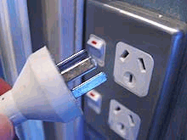

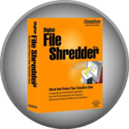
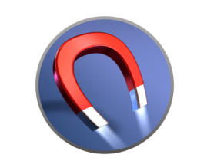
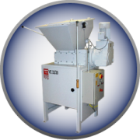
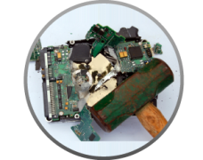

How the Drive Retirement Process Works (Non-SED Drives)
Retirement Options
Overwriting takes days and there is no notification of completion from drive
Retire Drive
Remove
ALL drives
Send even
“dead" drives
through
Queue in
Secure Area
Transport
Offsite
Queue in
secure area
Hard to ensure degauss strength matched drive type
Replace
Repair
Repurpose
SECURE
?
Shredding is environmentally hazardous
People make mistakes
Not always as secure as shredding, but more fun
“Because of the volume of information we
handle and the fact people are involved,
we have occasionally made mistakes.”
99% of Shuttle Columbia's hard drive data recovered from crash site
Data recovery specialists at Kroll Ontrack Inc. retrieved 99% of the information stored on the charred Seagate hard drive's platters over a two day period.
- May 7, 2008 (Computerworld)
which lost a tape with 150,000 Social Security numbers
stored at an Iron Mountain warehouse, October 2007¹
1. http://www.usatoday.com/tech/news/computersecurity/2008-01-18-penney-data-breach_
Drive Trust Alliance
Notes:
Seagate Confidential
13
Data centers routinely decommission drives. Many data center administrators mistakenly think that if they implement a procedure for employees to get rid of drive data before allowing the drive to leave the data center, they will avoid a data breach. However, all of these procedures rely on human beings to carry out these procedures. People make mistakes. A person must make sure to remove all drives from a system. They must rigorously follow the procedure to send even seemingly completely failed drives through the process. The drives must be queued up in a storage place, and may even need to be transported off site. Drives that are stored in a place waiting to go through these data destruction processes go missing, as happened at Iron Mountain and elsewhere. All employees from all sites who ever come in contact with drive must religiously follow these processes correctly.
Each one of these disposal techniques is a time-consuming process that is subject to human failure. It just takes one drive to fall through the cracks. AND these processes don’t address misplacement or theft. Also the process of destroying the data may not be foolproof. (FYI Space Shuttle Columbia disaster - Data recovery specialists at Kroll Ontrack Inc. retrieved 99% of the information stored on the charred Seagate hard drive's platters over a two day period. Drive held results of experiments conducted by crew. - May 7, 2008 (Computerworld) )) The most secure process, removing drive to destroy it, doesn’t address the desire to return for service/warranty or repurpose the drive.
Many data centers choose to hire professional disposal services. However, if you send a drive offsite to be securely disposed, that makes the drive just like tape, leaving the data center unsecured. What happens if en route to secure disposal at the outside service it ends up on ebay.
The beauty of encryption is that, the moment the drive or system is removed from the data center, either intentionally or not, it is secure, no advance action or thought is required. There’s no way for the drive to fall through the cracks or get mishandled.
----------------------------------
Idaho Power said it hired Grant Korth of Nampa, Idaho, to recycle about 230 SCSI drives. Korth sold 84 of those drives to 12 parties, which have not been disclosed by the company, using the eBay Web site.
various disposal options are riddled with failures/loopholes, that are either very expensive or not very secure, or like overwriting which can take days. All involve humans having to make sure nothing falls thru the cracks.
There are technical loopholes – Doing a reformat only rewrites about 1% of the sectors. It’s difficult to ensure the degauss strength matches the drive requirement. The drive doesn’t indicate when the overwrite process is complete, it could easily taking longer than the technician would assume.
There are issues of practicality - The destruction techniques DESTROY the drive; cannot be re-purposed. Physical destruction is not environmentally friendly and carries significant hauling and dumping costs.
Fundamentally, all of these processes are time-consuming, inconvenient, and prone to human error because the technician must remember to carry them out and carry them out precisely so that the procedure works as intended. There is also the risk of the process being short-changed overlooked altogether for any given drive.
Over-writing possibly requires HDD removal from existing system.
Recent trends indicate that the causes of data thefts and losses are generally low-tech, with human error far more likely to be responsible than hacking or computer flaws, according to Privacy Rights Clearinghouse Director Beth Givens.

Slide 14

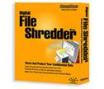
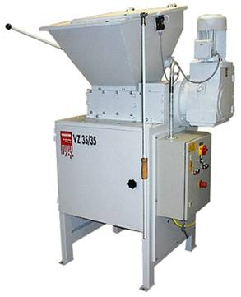

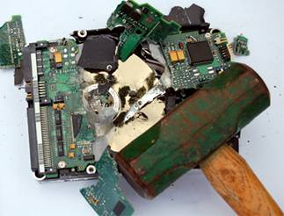
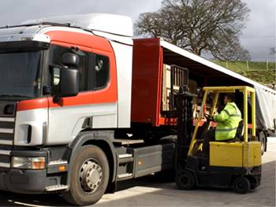
Disposal Options Are Riddled with Shortcomings
Formatting the drive or deleting the data
  Doesn’t remove the data - data is still readable
Over-writing
  Takes hours-to-days
  Error-prone; no notification from the drive of overwrite completion
Degaussing the disk drive
  Difficult to ensure degauss strength matched type of drive
  Very costly; error-prone; dependent on technicians who have other duties
  Loss of investment
Shredding
  Very costly; time-consuming; dependent on technicians who have other duties
  Environmentally hazardous
  Loss of investment
Smashing the disk drive
  Not always as secure as shredding, but more fun
  Environmentally hazardous
  Loss of investment
Disposing via professional offsite services
  Costly
  No guarantee of disposal
  Drive is exposed to the tape’s falling-off-the-truck issue
Drive Trust Alliance
Notes:
The various disposal options are riddled with failures/loopholes.
There are technical loopholes – Doing a reformat only rewrites about 1% of the sectors. It’s difficult to ensure the degauss strength matches the drive requirement. The drive doesn’t indicate when the overwrite process is complete, it could easily taking longer than the technician would assume.
There are issues of practicality - The destruction techniques DESTROY the drive; cannot be re-purposed. Physical destruction is not environmentally friendly and carries significant hauling and dumping costs.
But fundamentally, All of these processes are time-consuming, inconvenient, and prone to human error – prone to short-changing the process or prone to overlooking it altogether for any given drive. Companies have attempted to overcome these issues by employed maintenance services to securely dispose of their drives, and have found their drives on eBay. somehow, en route to a professional disposal service company-drives end up on ebay The process of transporting the drives to that service is equivalent to the tape scenario with the same tape-fell-off-the-truck vulnerability.
Idaho Power said it hired Grant Korth of Nampa, Idaho, to recycle about 230 SCSI drives. Korth sold 84 of those drives to 12 parties, which have not been disclosed by the company, using the eBay Web site.
----------------------------------------------------------------------------
Misc Notes
Over-writing possibly requires HDD removal from existing system.
ACTION, Writer: “dependent on technicians who have other duties” wording in the slide sounds weak. Change to "error-prone human involvement" or some such.
(It is a time-consuming inconvenience to the technician who must remember to carry them out, and carry them out precisely so that the procedure works as intended.)

Slide 15
How the Drive Retirement Process Works
Retirement Options
Drive Retirement is:
Expensive
Time-consuming
Error-prone
Overwriting takes days and there is no notification of completion from drive
Retire Drive
Remove
ALL drives
Send even
“dead" drives
through
Queue in
Secure Area
Transport
Offsite
Queue in
secure area
Hard to ensure degauss strength matched drive type
Replace
Repair
Repurpose
SECURE
?
Shredding is environmentally hazardous
People make mistakes
Not always as secure as shredding, but more fun
“Because of the volume of information we
handle and the fact people are involved,
we have occasionally made mistakes.”
99% of Shuttle Columbia's hard drive data recovered from crash site
Data recovery specialists at Kroll Ontrack Inc. retrieved 99% of the information stored on the charred Seagate hard drive's platters over a two day period.
- May 7, 2008 (Computerworld)
which lost a tape with 150,000 Social Security numbers
stored at an Iron Mountain warehouse, October 2007¹
1. http://www.usatoday.com/tech/news/computersecurity/2008-01-18-penney-data-breach_
Drive Trust Alliance
Notes:
Seagate Confidential
15
Data centers routinely decommission drives. Many data center administrators mistakenly think that if they implement a procedure for employees to get rid of drive data before allowing the drive to leave the data center, they will avoid a data breach. However, all of these procedures rely on human beings to carry out these procedures. People make mistakes. A person must make sure to remove all drives from a system. They must rigorously follow the procedure to send even seemingly completely failed drives through the process. The drives must be queued up in a storage place, and may even need to be transported off site. Drives that are stored in a place waiting to go through these data destruction processes go missing, as happened at Iron Mountain and elsewhere. All employees from all sites who ever come in contact with drive must religiously follow these processes correctly.
Each one of these disposal techniques is a time-consuming process that is subject to human failure. It just takes one drive to fall through the cracks. AND these processes don’t address misplacement or theft. Also the process of destroying the data may not be foolproof. (FYI Space Shuttle Columbia disaster - Data recovery specialists at Kroll Ontrack Inc. retrieved 99% of the information stored on the charred Seagate hard drive's platters over a two day period. Drive held results of experiments conducted by crew. - May 7, 2008 (Computerworld) )) The most secure process, removing drive to destroy it, doesn’t address the desire to return for service/warranty or repurpose the drive.
Many data centers choose to hire professional disposal services. However, if you send a drive offsite to be securely disposed, that makes the drive just like tape, leaving the data center unsecured. What happens if en route to secure disposal at the outside service it ends up on ebay.
The beauty of encryption is that, the moment the drive or system is removed from the data center, either intentionally or not, it is secure, no advance action or thought is required. There’s no way for the drive to fall through the cracks or get mishandled.
----------------------------------
Idaho Power said it hired Grant Korth of Nampa, Idaho, to recycle about 230 SCSI drives. Korth sold 84 of those drives to 12 parties, which have not been disclosed by the company, using the eBay Web site.
various disposal options are riddled with failures/loopholes, that are either very expensive or not very secure, or like overwriting which can take days. All involve humans having to make sure nothing falls thru the cracks.
There are technical loopholes – Doing a reformat only rewrites about 1% of the sectors. It’s difficult to ensure the degauss strength matches the drive requirement. The drive doesn’t indicate when the overwrite process is complete, it could easily taking longer than the technician would assume.
There are issues of practicality - The destruction techniques DESTROY the drive; cannot be re-purposed. Physical destruction is not environmentally friendly and carries significant hauling and dumping costs.
Fundamentally, all of these processes are time-consuming, inconvenient, and prone to human error because the technician must remember to carry them out and carry them out precisely so that the procedure works as intended. There is also the risk of the process being short-changed overlooked altogether for any given drive.
Over-writing possibly requires HDD removal from existing system.
Recent trends indicate that the causes of data thefts and losses are generally low-tech, with human error far more likely to be responsible than hacking or computer flaws, according to Privacy Rights Clearinghouse Director Beth Givens.

Slide 16
Drive Retirement: Self-Encrypting Drives
SE
C
U
R
E
Self-Encrypting Drives
Retire Drive
Remove
ALL drives
Send even
“dead" drives
through
Queue in
secure area
Transport
Offsite
Queue in
secure area
Replace
Repair
Repurpose
Power Off = Locked/Encrypted = Secure
Added “insurance”: Crypto Erase
Reduces IT operating expense
    Eliminates the need to overwrite or destroy drive
    Secures warranty and expired lease returns
    Enables drives to be repurposed securely
Provides safe harbor for most data privacy laws
Drive Trust Alliance
Notes:
Seagate Confidential
16
Data centers routinely decommission drives. Many data center administrators mistakenly think that if they implement a procedure for employees to get rid of drive data before allowing the drive to leave the data center, they will avoid a data breach. However, all of these procedures rely on human beings to carry out these procedures. People make mistakes. A person must make sure to remove all drives from a system. They must rigorously follow the procedure to send even seemingly completely failed drives through the process. The drives must be queued up in a storage place, and may even need to be transported off site. Drives that are stored in a place waiting to go through these data destruction processes go missing, as happened at Iron Mountain and elsewhere. All employees from all sites who ever come in contact with drive must religiously follow these processes correctly.
Each one of these disposal techniques is a time-consuming process that is subject to human failure. It just takes one drive to fall through the cracks. AND these processes don’t address misplacement or theft. Also the process of destroying the data may not be foolproof. (FYI Space Shuttle Columbia disaster - Data recovery specialists at Kroll Ontrack Inc. retrieved 99% of the information stored on the charred Seagate hard drive's platters over a two day period. Drive held results of experiments conducted by crew. - May 7, 2008 (Computerworld) )) The most secure process, removing drive to destroy it, doesn’t address the desire to return for service/warranty or repurpose the drive.
Many data centers choose to hire professional disposal services. However, if you send a drive offsite to be securely disposed, that makes the drive just like tape, leaving the data center unsecured. What happens if en route to secure disposal at the outside service it ends up on ebay.
The beauty of encryption is that, the moment the drive or system is removed from the data center, either intentionally or not, it is secure, no advance action or thought is required. There’s no way for the drive to fall through the cracks or get mishandled.
----------------------------------
Idaho Power said it hired Grant Korth of Nampa, Idaho, to recycle about 230 SCSI drives. Korth sold 84 of those drives to 12 parties, which have not been disclosed by the company, using the eBay Web site.
various disposal options are riddled with failures/loopholes, that are either very expensive or not very secure, or like overwriting which can take days. All involve humans having to make sure nothing falls thru the cracks.
There are technical loopholes – Doing a reformat only rewrites about 1% of the sectors. It’s difficult to ensure the degauss strength matches the drive requirement. The drive doesn’t indicate when the overwrite process is complete, it could easily taking longer than the technician would assume.
There are issues of practicality - The destruction techniques DESTROY the drive; cannot be re-purposed. Physical destruction is not environmentally friendly and carries significant hauling and dumping costs.
Fundamentally, all of these processes are time-consuming, inconvenient, and prone to human error because the technician must remember to carry them out and carry them out precisely so that the procedure works as intended. There is also the risk of the process being short-changed overlooked altogether for any given drive.
Over-writing possibly requires HDD removal from existing system.
Recent trends indicate that the causes of data thefts and losses are generally low-tech, with human error far more likely to be responsible than hacking or computer flaws, according to Privacy Rights Clearinghouse Director Beth Givens.

Slide 17
Certification and Compliance: Overview
Benefits:
Customer confidence in certified products
Signals product technology stability
Competitive advantage
TCG to host list of certified storage devices on the TCG website
Certification requires two mandatory parts:
  Compliance
  Security evaluation
Process to Approve Test Suite(s):
  Primary mechanism is through testing at compliance workshops
Device compliance process has three allowed options:
  Storage compliance workshop (fee to participate)
  Test house lab (fee set by lab)
  Self-certification (treated as a vendor test lab)

Slide 18
TCG Opal Certification Requirements
TCG Membership
Submit paperwork to the test lab
  Certification application
  Compliance test report
Submit security evaluation report
Submit application fee to TCG

Slide 19
Security Evaluation Overview
Common Criteria for the security evaluation
TCG Uses FDE EE cPP Specification Published by the iTC
  FDE: Full Disk Encryption
  cPP: collaborative Protection Profile
  EE: Encryption Engine
  iTC: international Technical Committee
  Document: collaborative Protection Profile for Full Drive Encryption - Encryption Engine Version 2.0 September 09, 2016
  CC labs: https://www.commoncriteriaportal.org/labs/

Slide 20
TCG Opal Certification Program: Status
Opal Test Cases published on March 2016
TCG Storage Compliance Workshop on May 2016
Certification Launch after:
  Test Suite Approval
  Test House Approval
  Certification Program Approval
  Estimate: YE 2016

Slide 21
References to TCG SEDs
NVMe, UFS
NIST SP800-88R1
ISO/IEC 27040

Slide 22
TCG and NVMe(xpress) Liaison: Joint White Paper
The Opal “Family” of specifications published by the Trusted Computing Group provides a scalable infrastructure for managing encryption of user data in a Storage Device, as well as extensibility to enable features beyond “data at rest protection”.
The protocols associated with management of encryption capabilities provided by Opal and its subset specs, Opalite and Pyrite, range from light to thorough, with further scalability up to meet even fuller featured levels of capability; and further scaling down possible to enable even more use cases than those already being addressed.
The scalability of the architecture and solutions embodied in the TCG Storage specifications provides an ideal match for the scalability provided by the NVMe specification and aligns with the Opal Family of specifications as the security management interface for both NVMe client and data center Storage Devices.
>>> Result: Joint and detailed technical specifications between the
two organizations
http://www.trustedcomputinggroup.org/wp-content/uploads/TCGandNVMe_Joint_White_Paper-TCG_Storage_Opal_and_NVMe_FINAL.pdf

Slide 23
NIST SP800-88R1 Summary:
Guidelines for Media Sanitization
Media sanitization and information disposition activity is usually most intense during the disposal phase of the system life cycle. However, throughout the life of an information system, many types of media, containing data, will be transferred outside the positive control of the organization. This activity may be for maintenance reasons, system upgrades, or during a configuration update.
Media sanitization is one key element in assuring confidentiality.
Cryptographic Erase (CE) is an emerging sanitization technique that can be used in some situations when data is encrypted as it is stored on media. With CE, media sanitization is performed by sanitizing the cryptographic keys used to encrypt the data, as opposed to sanitizing the storage locations on media containing the encrypted data itself. CE techniques are typically capable of sanitizing media very quickly and could support partial sanitization, a technique where a subset of storage media is sanitization. Partial sanitization, sometimes referred to as selective sanitization, has potential applications in cloud computing and mobile devices.
Crypto Erase: Sanitization Standard
http://nvlpubs.nist.gov/nistpubs/SpecialPublications/NIST.SP.800-88r1.pdf

Slide 24
INTERNATIONAL STANDARD ISO/IEC 27040
Reference number ISO/IEC 27040:2015(E)
First edition 2015-01-15
Information technology — Security techniques — Storage security
Technologie de l’information — Techniques de sécurité — Sécurité de stockage
http://www.iso.org/iso/catalogue_detail?csnumber=44404

Slide 25
ISO/IEC 27040: Excerpts
Cryptographic erase leverages the encryption of target data by enabling sanitization of the target data’s encryption key. This leaves only the ciphertext remaining on the data, effectively sanitizing the data…..
“Cryptographic Erase through the TCG OPAL SSC or Enterprise SSC interface by issuing commands as necessary to cause all MEKs to be changed ….” (to be explained shortly!)
Other cryptographic erase considerations:
— If the encryption key (or any key at or below the level of key sanitized during cryptographic erase) exists outside of the storage device (typically due to escrow or injection), there is a possibility that the key could be used in the future to recover data stored on the encrypted media.
— Sanitization using cryptographic erase should not be trusted on devices that have escrowed or injected the key(s) unless the organization has a high level of confidence about how and where the keys were stored and managed outside the device.
READ: Use Self-Encrypting Drive (SED) storage!

Slide 26
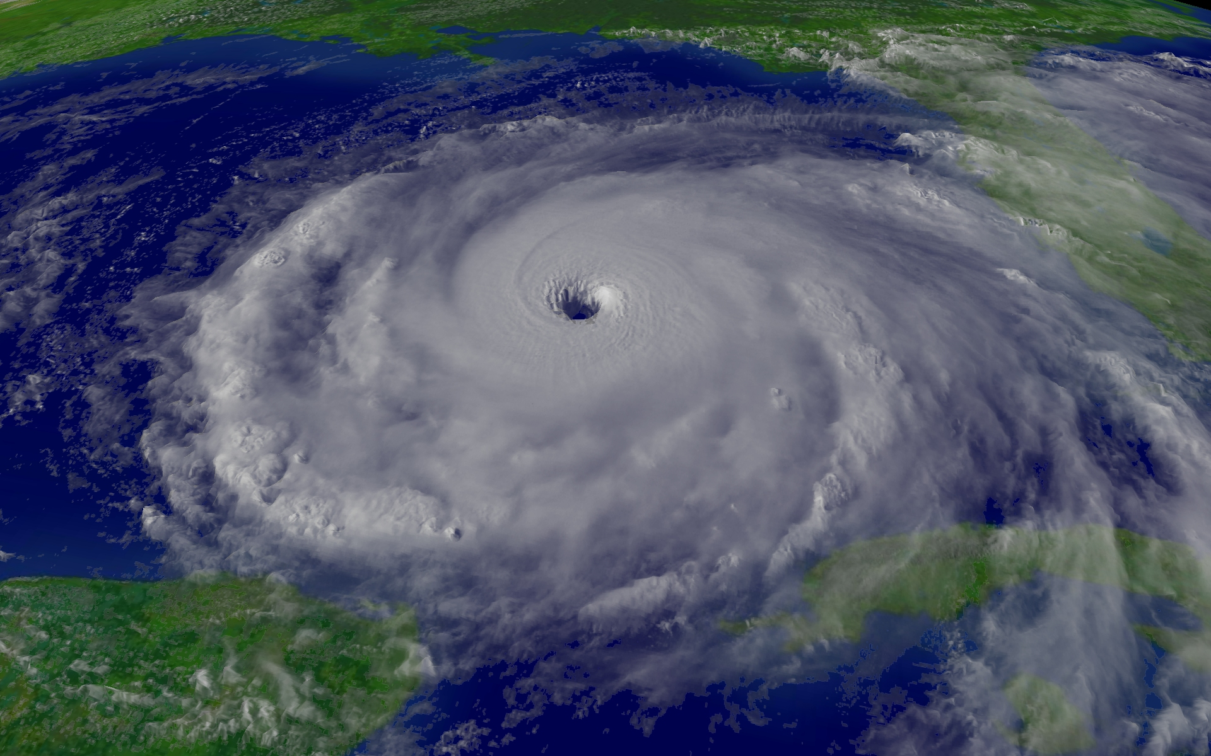

Crypto-Erase: “Perfect Storm”
Business requirements
Technical definition
(TCG)
Promotion
(TCG, DTA)
Self-Encrypting Storage
Crypto-Erase
Standardization
(TCG, NIST, ISO)
Best practices
(SNIA)
Product proliferation
(multi-vendor)
Legislative mandates
(breach notification)

Slide 27
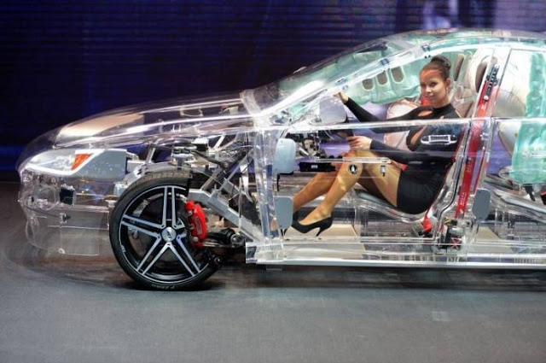
Automotive Use Cases
Purpose: Protect the Privacy of User Data (when the user isn’t using it)
Your car key (phone, whatever) that starts your car should cryptographically unlock all the data you and your passengers need.
When you sell your car (repurpose a corporate vehicle, whatever) you should be able to cryptographically erase all user data very quickly (logging into your car’s web site).
SEDs enable crypto erase of user data
http://www.drivetrust.com/autoerase
Privacy Sensitive Data ☺
Drive Trust Alliance

Slide 28
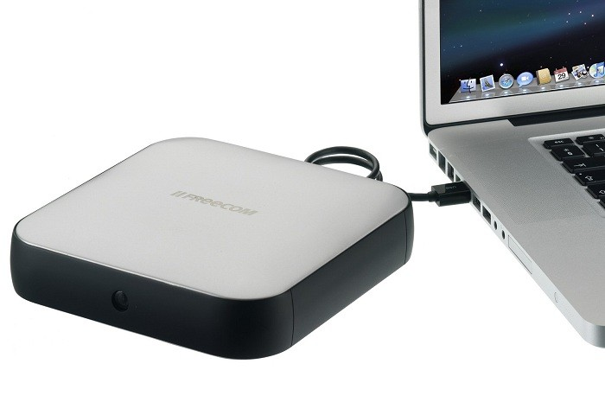
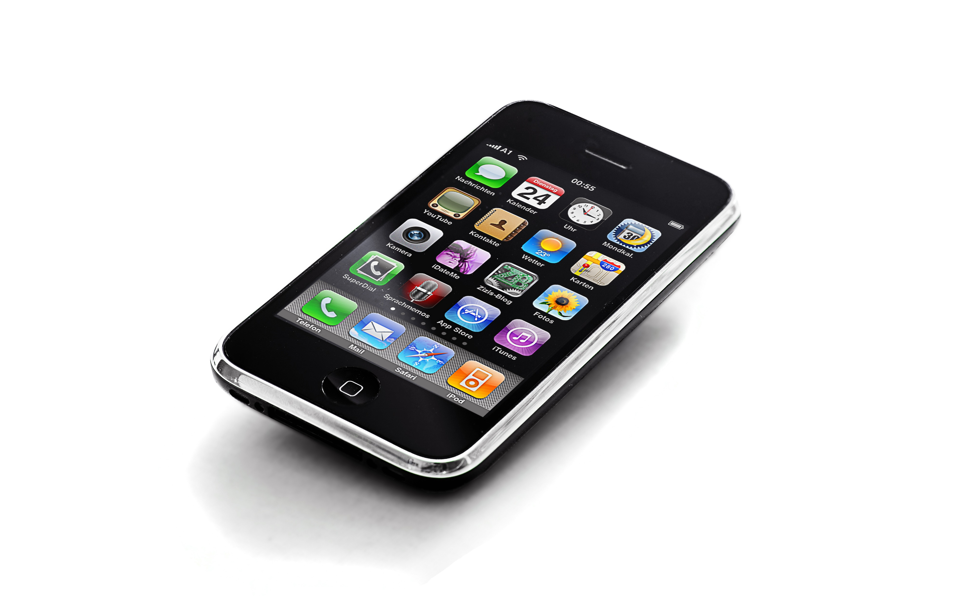
Mobile Use Cases
USB SED – MAC – iPhone
iPhone unlock-lock of TCG Opal USB drive on MAC
-- send encrypted drive to destination
-- unlock when you confirm the destination
actually has it
iPhone location proximity
-- unlock TCG Opal USB drive using iPhone as the authentication token
http://www.drivetrust.com/apps

Slide 29
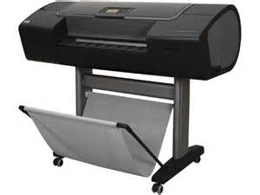
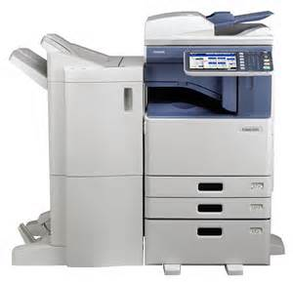
IoT Use Cases
High-performance self-encrypting drive: Protect and secure your most sensitive HP Designjet Printer data
Device performance and reliability are not impacted. Print documents to your printer and help reduce the risk of unauthorized access.
…………………………………………………………………..
Toshiba eStudio 3055C Copier offers Toshiba’s Self Encrypting Drive equipped with our Wipe Technology as well as a suite of impressive security functions to keep data protected.

Slide 30
SEDs Are Ubiquitous
100% of all new, office and enterprise Solid State Drives (SSDs) are TCG Opal SEDs
  Why? Traditional erasure techniques fail. SEDs provide instant crypto erase
100% of all enterprise storage (SSD, HDD, etc) are based on TCG standards for enterprise SEDs
  Huge data centers and cloud services using SEDs, i.e. Google, Facebook and many others
  Fast, safe, and effective cryptographic repurposing and disposal of storage devices; protect against data leakage
100% of all Apple iOS devices are hardware SEDs for user data
  when iPhone or iPad password is set, that is the KEK (Key Encrypting Key)
100% Western Digital USB Drives (HDDs) are SEDs
  In case you lose your USB storage device
100% of ALL office-class printers and copiers in the world use SEDs
  Protect against theft of what people have printed/copied
Many consumer HDDs in PCs are based on TCG SED standards
  Microsoft Bitlocker supports “eDrive” which requires Opal 2.0 SEDs
100% TCG Opal Drives also support the SATA Security Password (Hard Disk Password)
  No software needed: already supported by BIOS/UEFI setup on nearly every laptop and PC in the world
  Newest fastest solid state drives, such as NVMe, are already commercially available as TCG SEDs.
  TCG is working with other standards groups re implementation
http://www.drivetrust.com/education/education
Drive Trust Alliance

Slide 31
Where to Find SEDs
Hard Disk Drives
  Seagate: OPAL, Enterprise
  Western Digital – HGST (Hitachi): OPAL, Enterprise
  Toshiba: OPAL, Enterprise
Solid State Drives
  Intel: OPAL, Enterprise
  Micron: OPAL
  Samsung: OPAL
  SanDisk: OPAL
  Seagate: OPAL, Enterprise (SandForce controllers)
  Toshiba: OPAL, Enterprise
USB-attached
Drive Trust Alliance Open Source

Slide 32
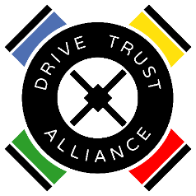
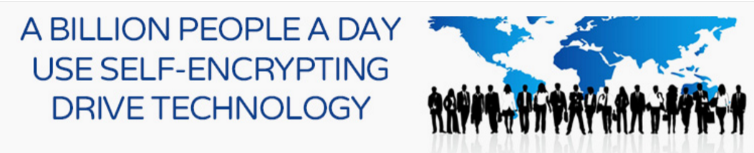
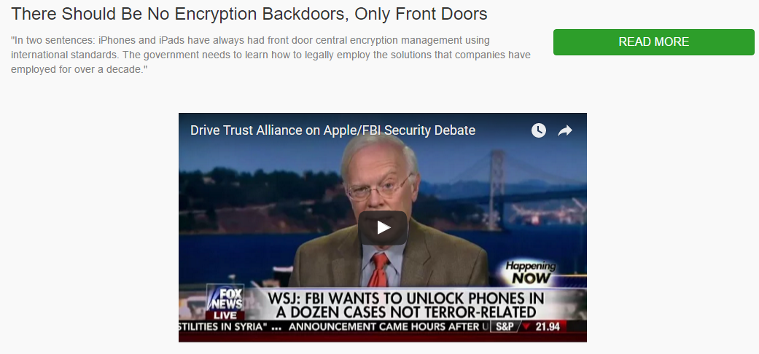
Drive Trust Alliance
TCG Member/SED advocacy
Flash SSDs
iPhones, iPads, Android
All of Google
All Printers
Protecting “USER” Data
Copyright Robert Thibadeau rht@brightplaza.com
Drive Trust Alliance

Slide 33
Case Study: Barnabas Health
  New Jersey’s largest integrated health delivery system
  Implemented SEDs in 2380 laptops used by doctors, nurses, administrators and executives across 25 facilities
  Will be encrypting 13,000 desktops used in the hospitals, via the asset lifecycle process, in 4 years; 400 units initially.
Key Findings:
  24 hours faster deployment on average per user over previous software-based encryption
  Negligible boot time versus up to 30 minutes to boot a PC with software encryption
33

Slide 34
Summary
SEDs are widely available (client/data center) & add little to no cost to IT operations
SEDs provide always-on encryption with no performance impact to users
SEDs offer instant erasure of drives
SEDs support current and emerging data protection and safe harbor laws worldwide
SEDs are available in many form factors and can be used in not only PCs/servers but in any device that needs storage (industrial systems, office equipment, network gear, automobiles, kiosks/ATMs, mobile devices and any other with memory)

Slide 35
Resources
http://www.trustedcomputinggroup.org/work-groups/storage/
https://www.drivetrust.com
http://www.embedded.com/electronics-blogs/max-unleashed-and-unfettered/4442291/Secure-your-data-with-self-encrypting-drives--SEDs-

Slide 36
QUESTIONS?

